Slide 1
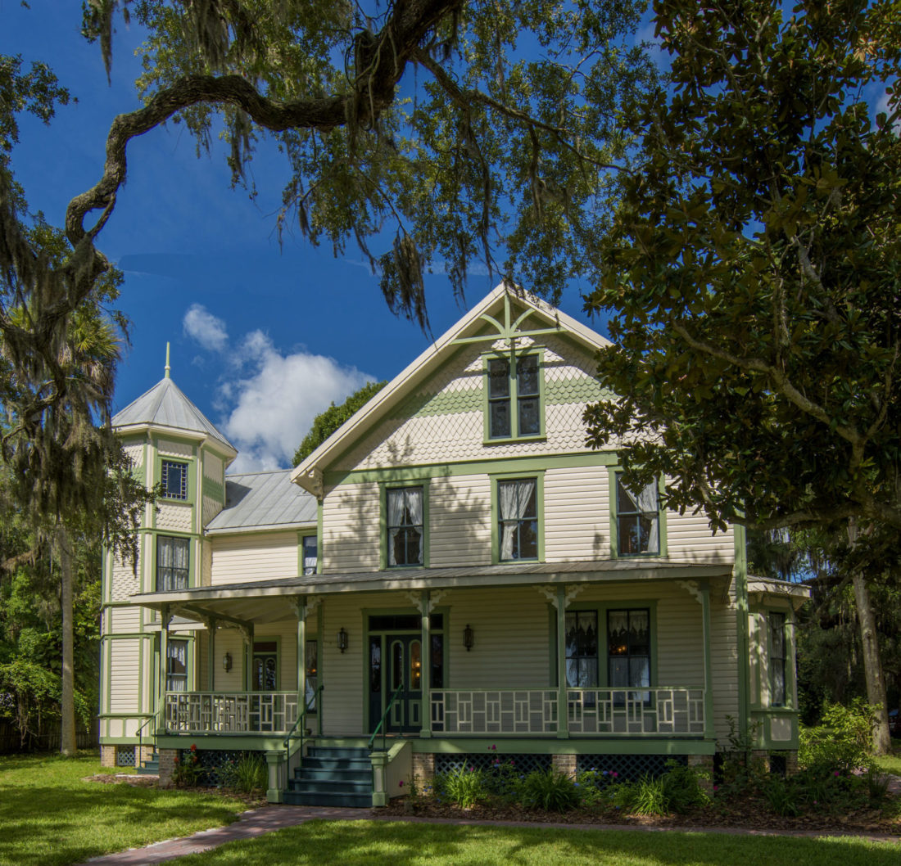
Lawndale Museum
Rockledge, Florida

Slide 2
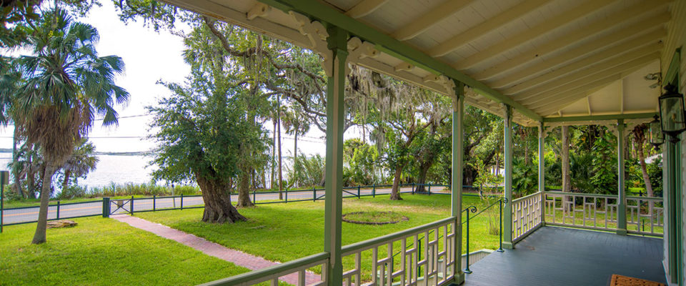
The property is listed on the National Register of Historic Places as part of the
Rockledge Drive Historic District
Lawndale is a historic home in Rockledge, Florida, built by Hiram Smith Williams.
Lawndale was completed in 1874 and is of Queen Ann style architecture for both interior and exterior design
Brevard County purchased home in 1989 to become a museum
Now 100% cared for through volunteers and the Preservation and Education Trust

Slide 3
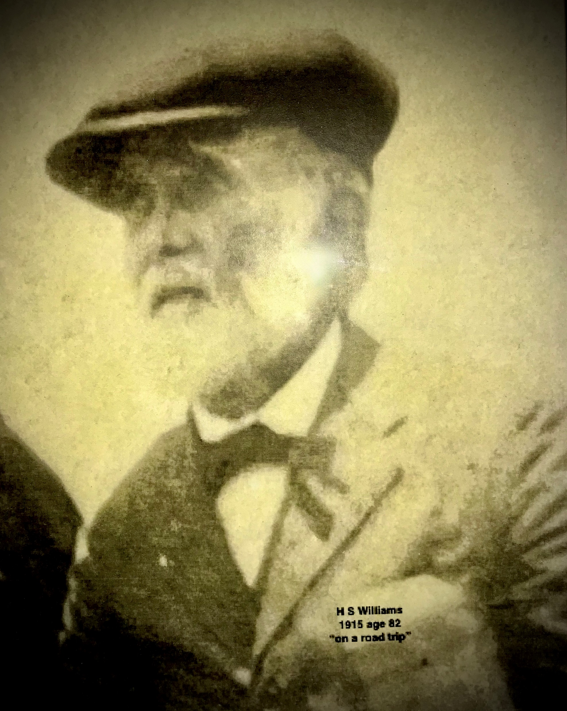
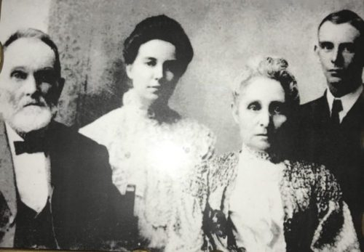
Lawndale began with…H.S. Williams.
Carriage builder by trade, carpenter
Lived in MANY parts of our country until settling in Rockledge in 1874
Started a citrus business
Became a major contributor to our county through his responsible actions-
First postmaster and state senator, county treasurer, school trustee and established our first schoolroom in his house. Brought telephone service to the county in the early 1900’s.
Hiram Smith ( H.S.) Williams
The Williams Family

Slide 4
Some of the views of the Lawndale Museum
A living history museum, to present what life was like in the late-nineteenth century in Rockledge.

Slide 5
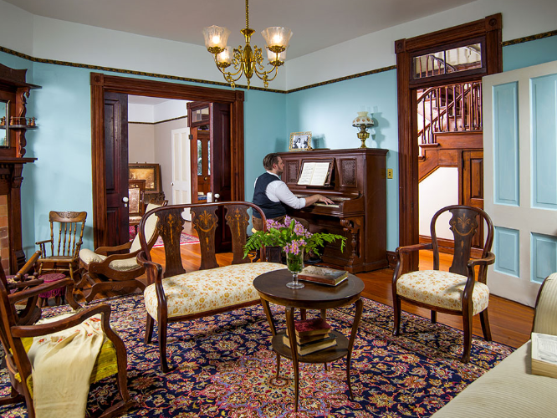

Slide 6
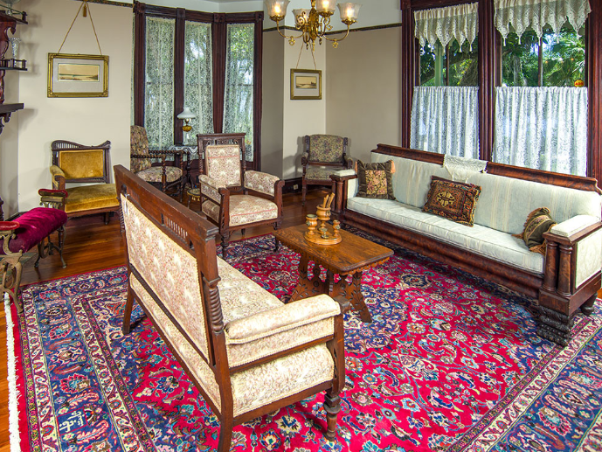

Slide 7
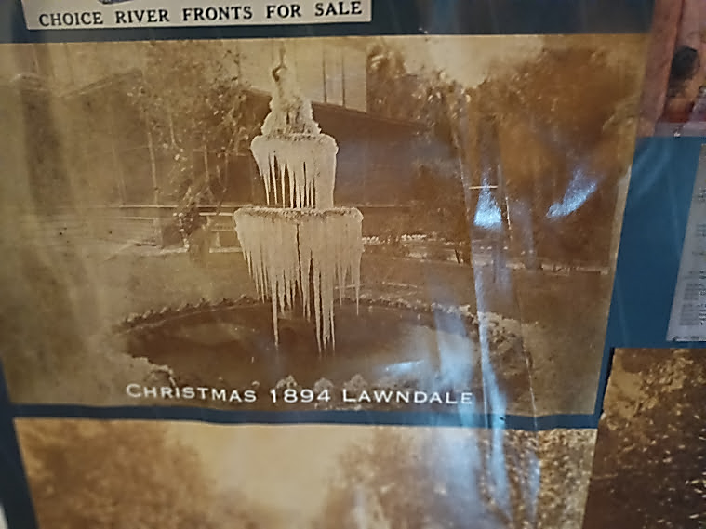
Former Fountain in front yard- during a tough freeze- 1894

Slide 8
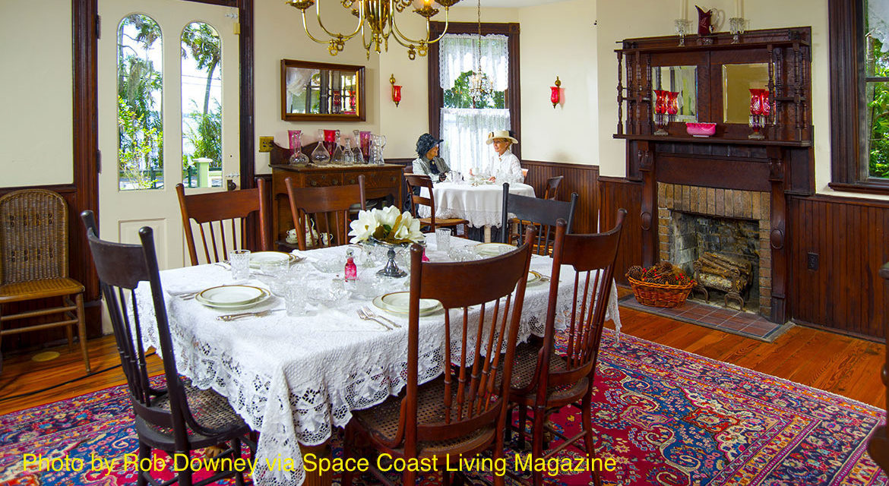

Slide 9
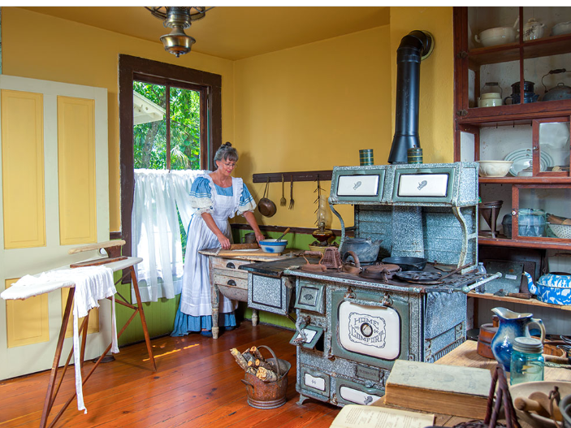

Slide 10
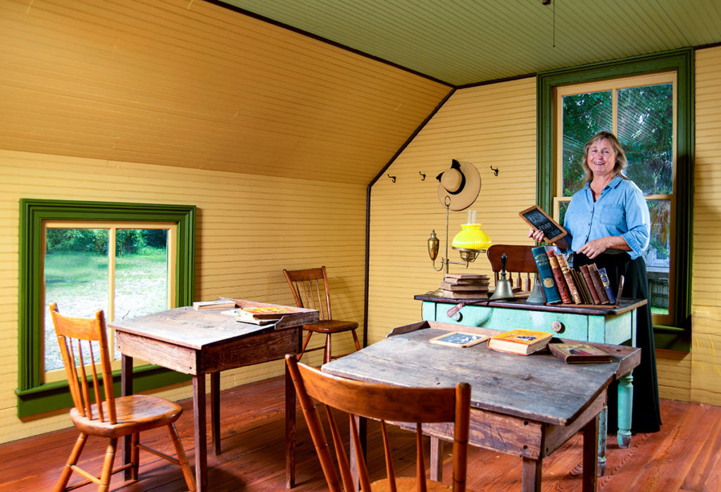
It is believed that the school room is one of the first schools that was in the county, providing education for not only the Williams children but also children from the neighborhood.

Slide 11
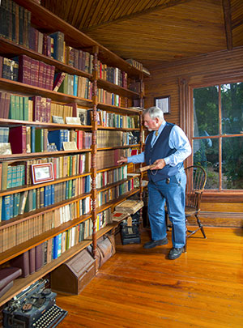
On the second floor is the office of H. S. Williams which includes the extensive family library.

Slide 12
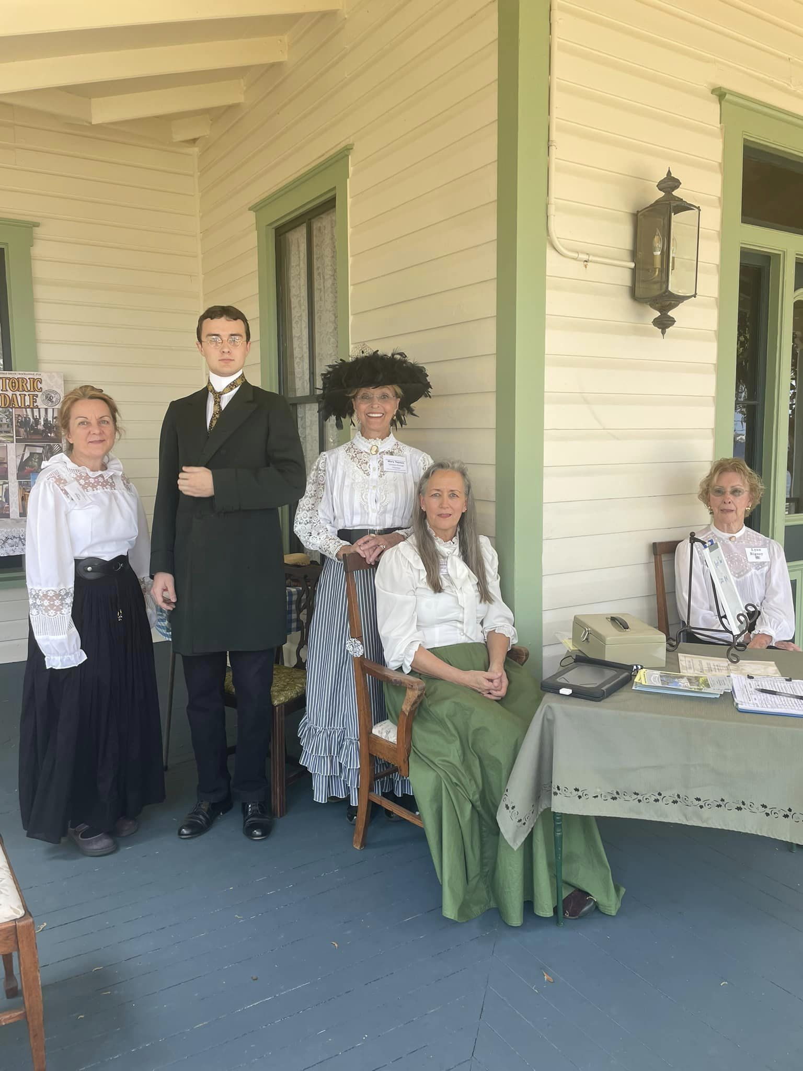
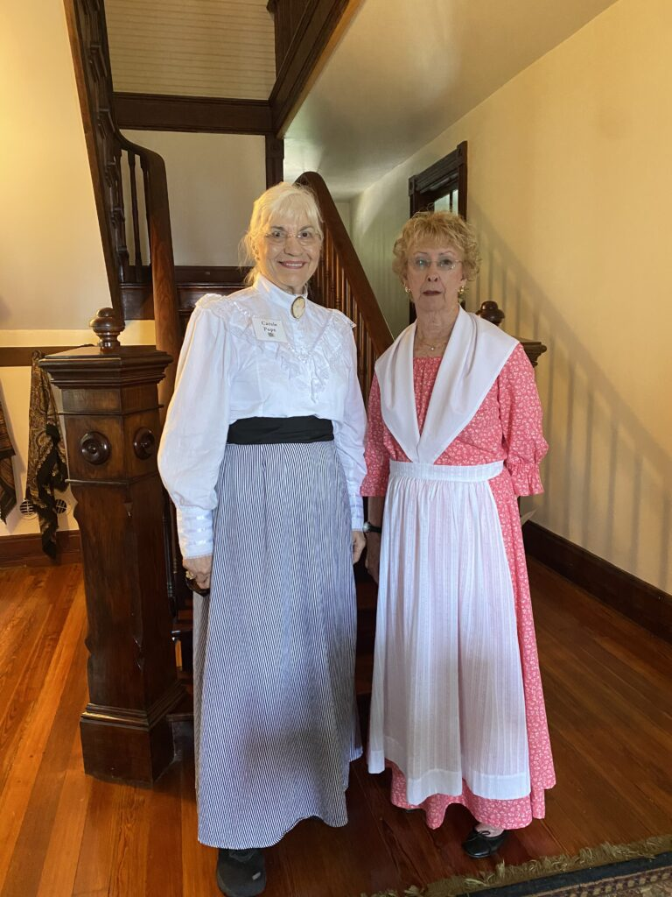
Volunteers and guides reflect the dress and decorum of the times of the 1800’s for the tours that occur on the first and third Saturdays of each month.
Regular Hours The 1st & 3rd Saturday of Every Month from 10am – 3pm.
Other Hours Requests for Tours Outside of the Regular Hours can be submitted via an email to: FriendsofLawndale@gmail.com
Admission – $10 Donation

Slide 13
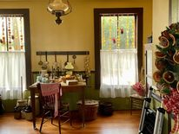
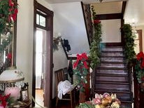
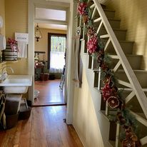
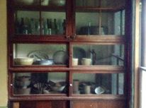

Slide 14
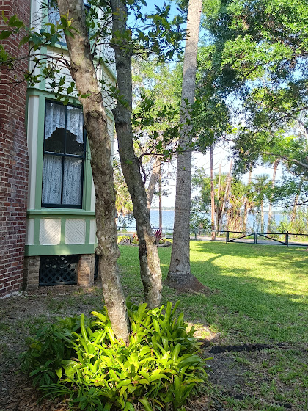
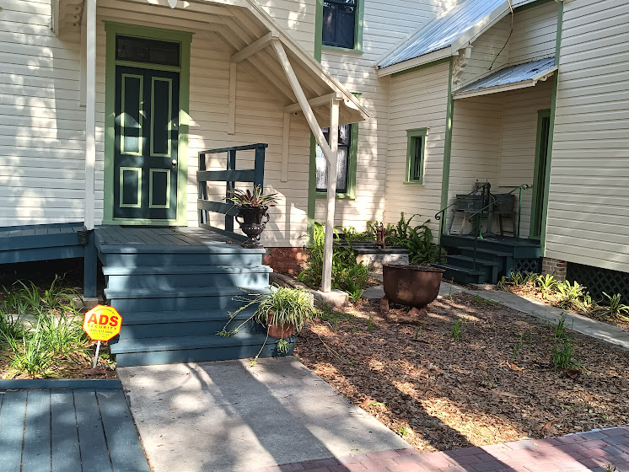
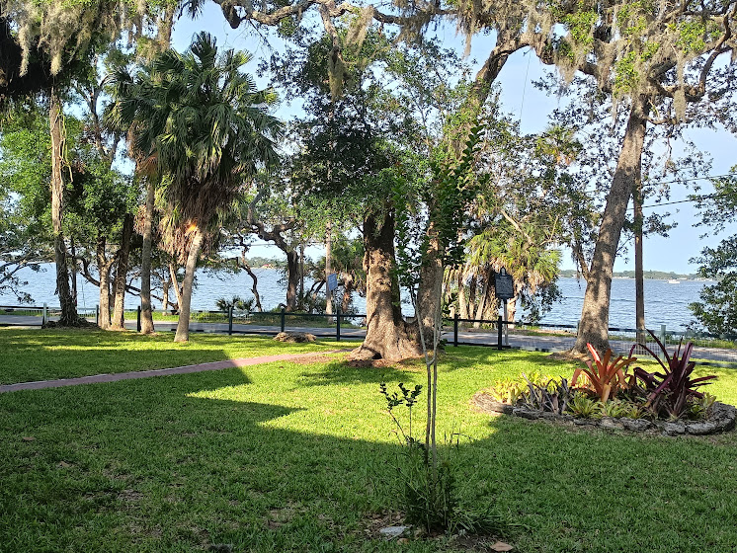

Slide 15
Lawndale
contains some examples of types of horticultural practices from the last century

Slide 16
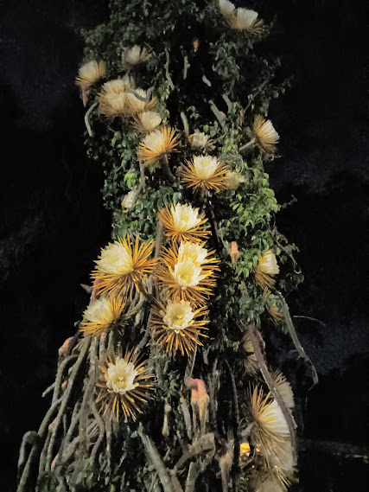
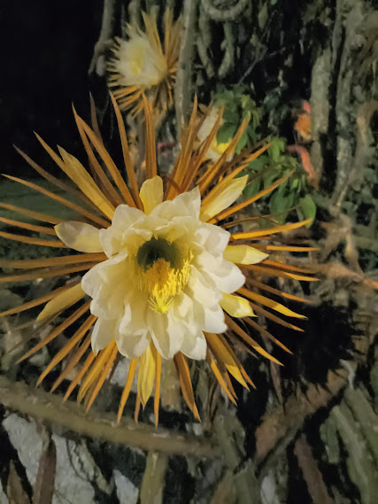
Night Blooming Cereus– a wonderful night gift during most of June

Slide 17
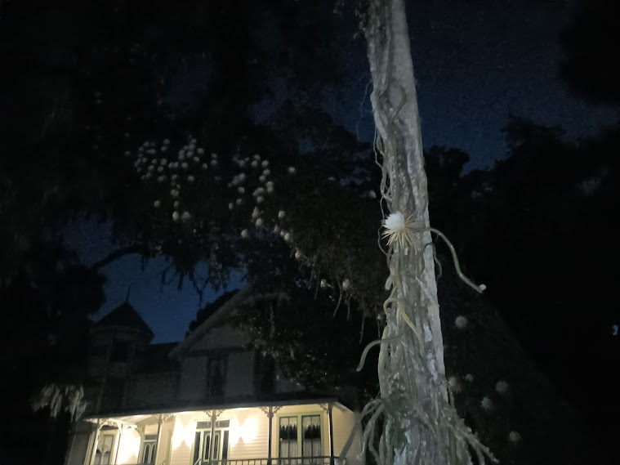

Slide 18
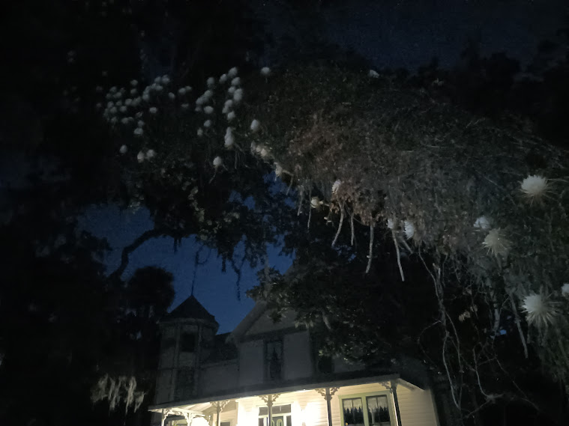

Slide 19
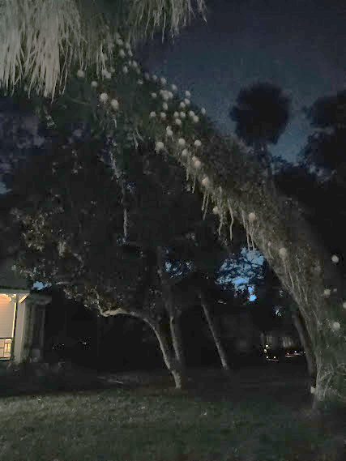
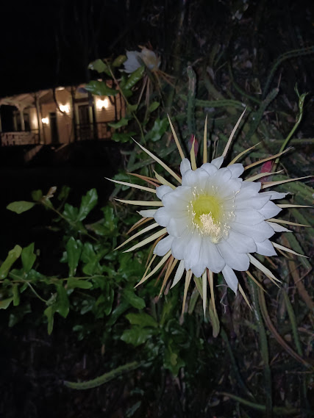

Slide 20
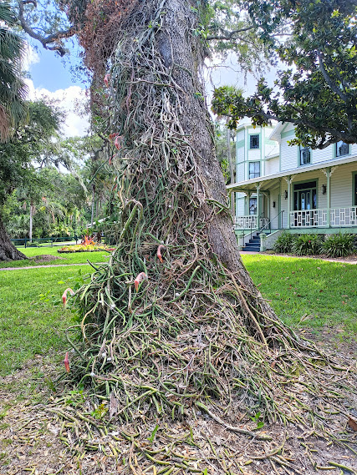
Not that attractive until the blooms begin

Slide 21
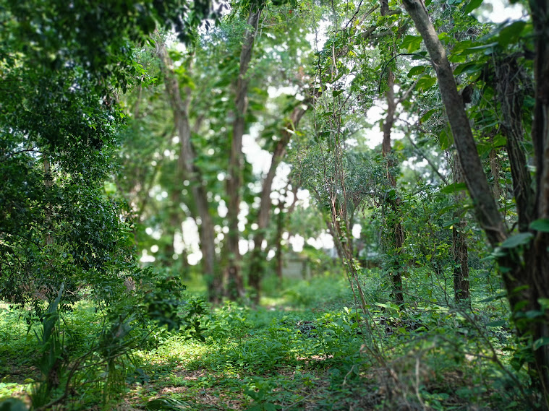
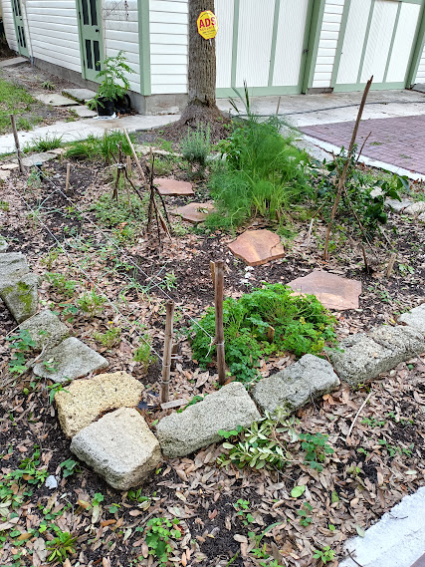
Backyard areas of Lawndale

Slide 22
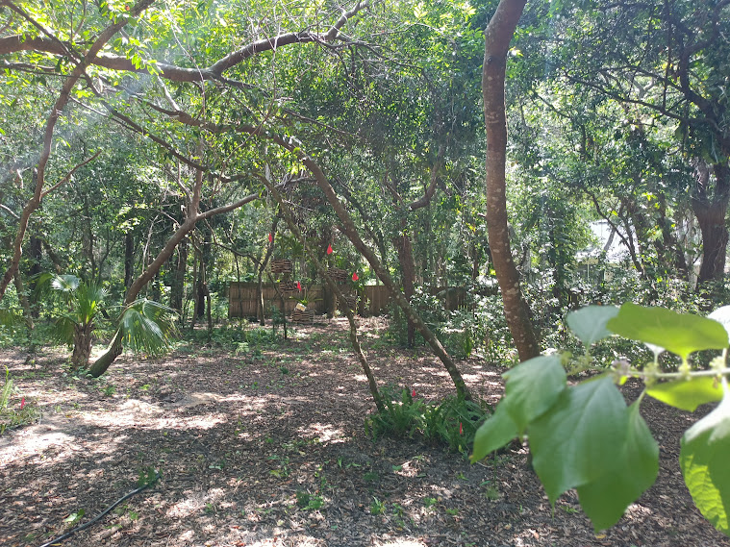

Slide 23
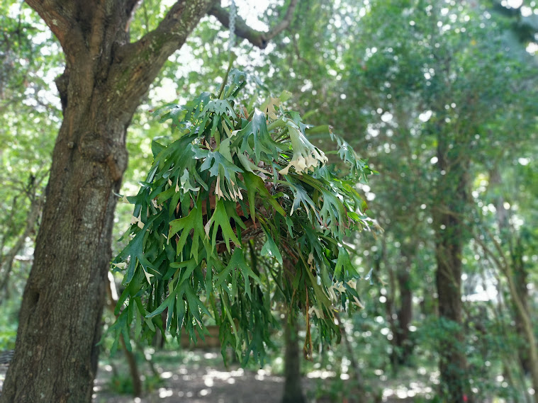

Slide 24
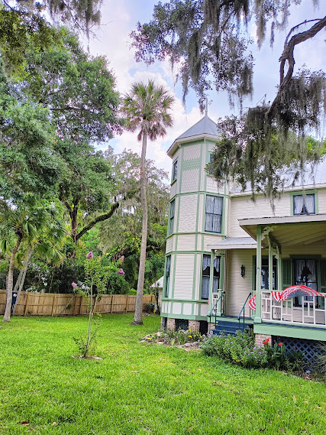
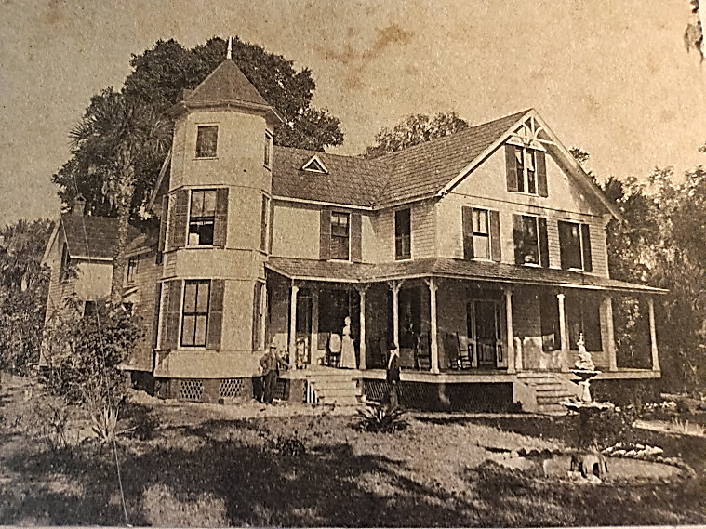
Some plants endure!!

Slide 25
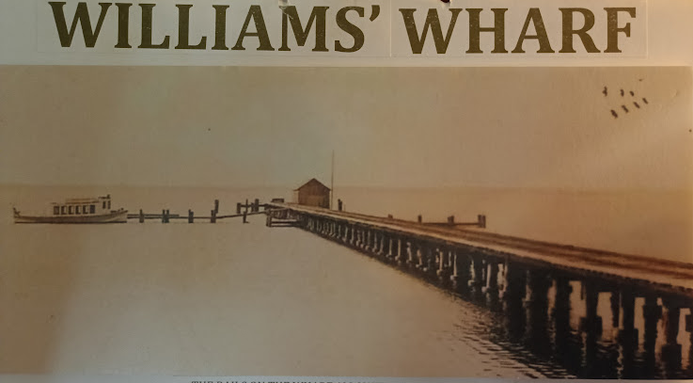
THE RIVER FRONT OF LAWNDALE
The rails on the wharf allowed a “tram” or wagon to move easily with its heavy load.

Slide 26
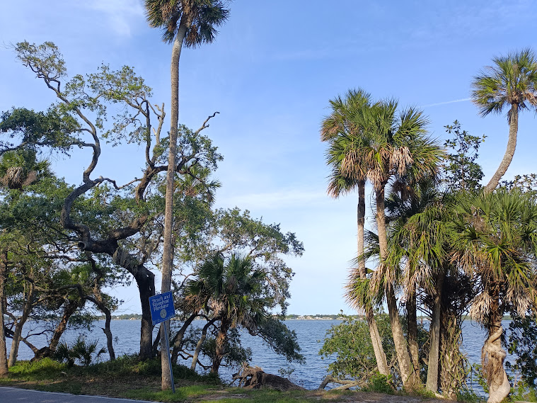
Today’s Indian Riverfront View….

Slide 27
Lawndale consists of more than an acre of property
Nearly 4,000 square feet of living space, a carriage house and a wonderful waterfront view that will take you back to a peaceful time in the late 1800’s.
The tour includes the first and
second floor of the home and
requires the guests to use
stairways. For those who aren’t
able or choose not to use the
stairway, a series of storyboards
can be used to virtually share
information regarding the
Lawndale history.

Slide 28
The museum is open for tours on
Saturday from 10am until 3pm.
The location is 1219 Rockledge Drive,
Rockledge FL 32955
Admission – $10 donation per person.
No reservation required.
We are also available for private or
group tours, please contact us at
FriendsOfLawndale@gmail.com
or (321) 632-5650.

Slide 29
We are looking for new memberships to keep Lawndale sustainable and successful. Please consider one of the following options:
Annual Membership
A membership with Lawndale supports the ongoing efforts to preserve this historic landmark and provides you with a connection to the success of the museum.
All memberships include 12 months of unlimited access to the scheduled museum tours, Museum updates via our electronic newsletter, “The Lawndale News”, as well as a personal invitation to our annual members celebration.
Lawndale is a 501(C)3 Not For Profit Organization - State of Florida # CH67785

Slide 30
The following levels of Memberships are available.
Individual $30 – Membership benefits for one person
Couple $50 – Membership benefits for two persons
Family $100 – Membership benefits family members
Patron $150
Membership benefits for 4 adults
Recognition on our “Donors of Lawndale List”
Friend $250
Membership benefits for 6 adults
Recognition on our “Donors of Lawndale List”
One private guided tour for up to 8 guests, please allow 2 weeks for scheduling
Fellow $500
Membership benefits for 8 adults
Recognition on our “Donors of Lawndale List”
One private guided tour for up to 8 guests, please allow 2 weeks for scheduling
Invitation to one special exhibition VIP opening celebration

Slide 31
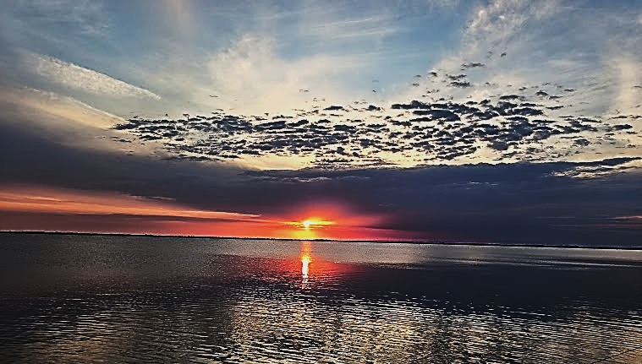
Welcome to Lawndale
You are welcomed to Lawndale Museum

